Slide 2
Data Science and Machine Learning 101
Daniel Grecoe
Senior Software Engineer

Slide 3
Session Goals
Understand Data Science Concepts
Terminology of the data scientist
What is “good” data?
What is supervised/unsupervised training?
Azure Machine Learning Studio
How to build a machine learning model and publish it for external consumption.
Make your application smarter with machine learning, consuming a model
Notes:
This slide is required. Do NOT delete. This should be the first slide after your Title Slide.
This slide should describe what your goals are for this session. This information lets your audience know what you are trying to accomplish with your talk or tutorial—ie, what value will attendees get by investing 25 minutes or 2 hours of their time listening to you.
You should not spend more than 1 minute presenting this slide.
General examples of session goals could be (you will have to create your own specific goals):
Introduce a new technique or approach to solve a customer problem
Compare two approaches and explain why one is superior
Describe a project and the learnings that audience members can apply from it
Teach audience members how to use a specific technology

Slide 4
Solving problems…it’s what we do
Traditional approach is rules based
Problem specification
Software creation
Deploy/Deliver
Patch
Machine learning
Use exposed cloud API’s to make applications smarter…
ML models can be retrained without rebuilding the application

Slide 5
What is Machine Learning?
Computer systems that become smarter with experience.
“Experience” = past data + human input

Slide 6
Data…
Training Data : A set of samples
Sample : A single observation
Features: Individual columns in the data set
Label: Historical results related to a sample

Slide 7
Human Input
Domain of the data scientist and the SME
Data must be….
Relevant
Connected
Accurate
Enough of it

Slide 8
Vague questions vs. Sharp questions
The Sharp Question
Can’t be answered with a name or a number
What can my data tell me about my business?
What should I do?
Can be answered with a name or a number.
How many Model Q Gizmos will I sell in Montreal during the third quarter?
Which car in my fleet is going to fail first?

Slide 9
Types of Learning
Do we have labels to go along with the features?
Yes - Supervised
Infer a function from labeled training data
Prediction / Classification
No - Unsupervised
Finds patterns and relationships in features
Clustering / Anomaly

Slide 10
Machine Learning Problems
Prediction
Classification
Anomaly
Clustering
Object Detection*

Slide 11
Azure Machine Learning Service
Data
Clients
API
ML STUDIO
Model is now a web service that is callable
Blobs and Tables
Hadoop (HDInsight)
Relational DB (Azure SQL DB)
Integrated development environment for Machine Learning

Slide 12
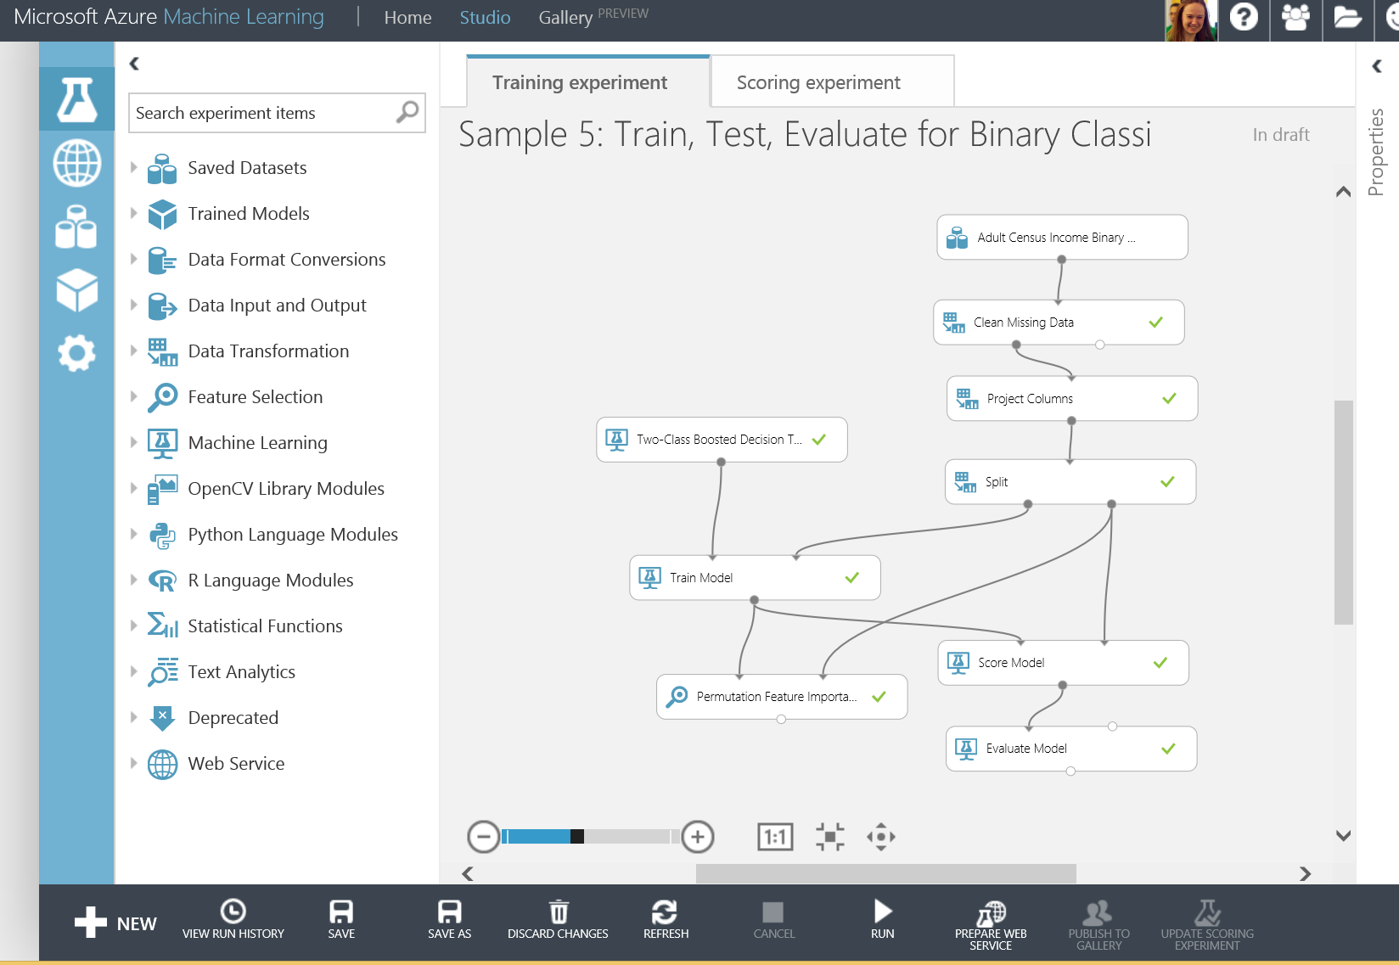
Azure Machine Learning Studio
https://studio.azureml.net

Slide 13
Factory Demo

Slide 14



Azure Machine Learning Service
CloudML Service
CloudML Service
Factory Gadget IOT Example

Slide 15
Training Data

Slide 16
AML Studio Demo

Slide 17
Typical Pipeline Design

Slide 18
Resources
Cortana Intelligence Suite: https://www.microsoft.com/en-us/cloud-platform/cortana-intelligence-suite
ML Studio: https://studio.azureml.net
Gallery: https://gallery.cortanaanalytics.com/
Marketplace: https://azure.microsoft.com/en-us/marketplace/
DS Cheat Sheet: https://azure.microsoft.com/en-us/documentation/articles/machine-learning-algorithm-cheat-sheet/

